Slide 1
Attrition Study
DS6306 Case Study 2

Slide 2
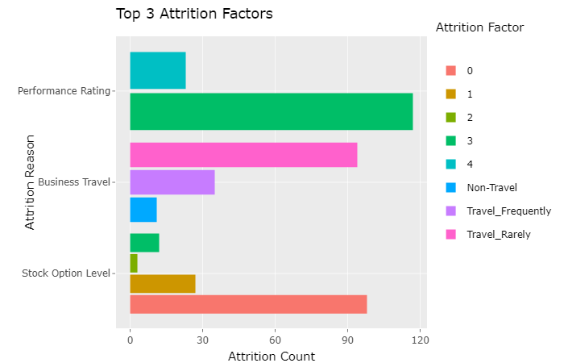
Top 3 Attrition Factors

Slide 3
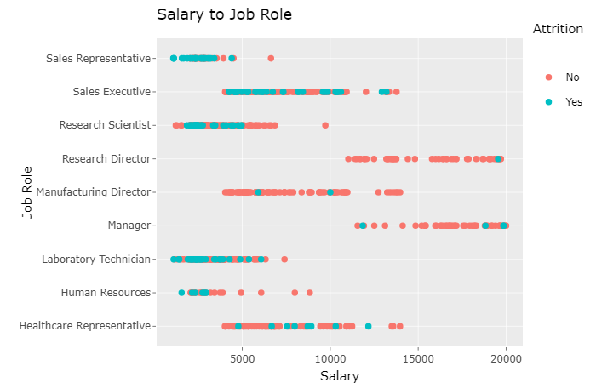
Education | JobRole | count
1 | Research Scientist | 16
2 | Research Scientist | 30
3 | Research Scientist | 78
4 | Research Scientist | 44
5 | Research Scientist | 4

Slide 4
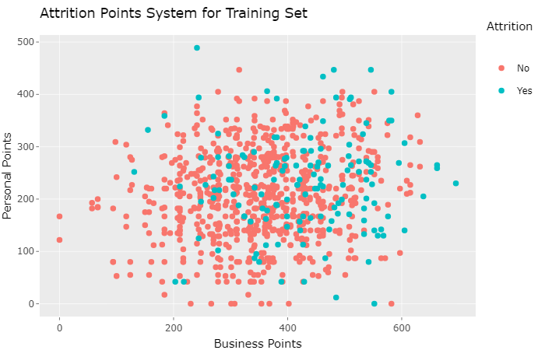
Points System
The top 20 factors are assigned Personal Points, or Business Points.
The points are given based on the count of 'Yes'. Factors with more counts of 'Yes' rank higher.
Personal Points
Reason | Factor | Num 'Yes'
Gender | Male | 87
WorkLifeBalance | | 3 | 80
MaritalStatus | Single | 70
NumCompaniesWorked | 1 | 60
Education | 3 | 55
EducationField | Life Sciences | 53
EnvironmentSatisfaction | 1 | 42
RelationshipSatisfaction | | 4 | 42
DistanceFromHome | 1 | 17
Age | 29 | 12
Business Points Reason | Factor | Num ‘Yes’
PerformanceRating | 3 | 117
StockOptionLevel | 0 | 98
BusinessTravel | Travel_Rarely | 94
JobLevel | 1 | 86
OverTime | Yes | 80
Department | Research & Development | 75
JobInvolvement | 3 | 67
YearsSinceLastPromotion | 0 | 63
TrainingTimesLastYear | 2 | 57
JobRole | Sales Executive or Research Scientist | 33

Slide 5
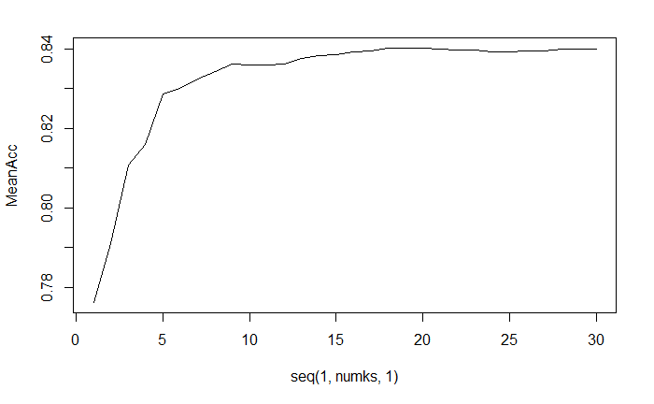
Model Accuracy
Classifications No Yes
No 207 33
Yes 15 6
Confusion Matrix and Statistics
Accuracy : 0.8161
Sensitivity : 0.9324
Specificity : 0.1538

Slide 6
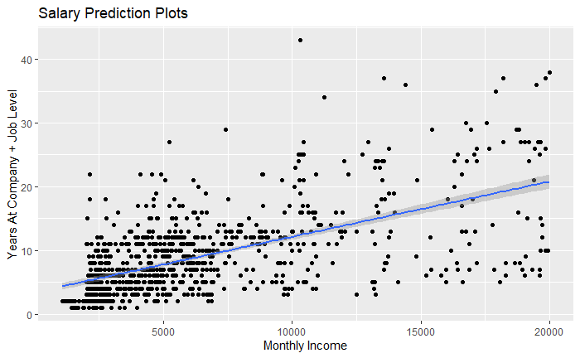
Salary Prediction
Residual standard error: 1414 on 867 degrees of freedom

Slide 7
Recap
Top 3 Attrition Factors
Job Role Trend
Points System
Model Accuracy to Predict Attrition
Model Accuracy to Predict Salary

